Slide 1
Assessment
Circulating Fluidized Bed Boiler
Dowon SHUN
Korea Institute of Energy Research
Notes:
산업용 보일러의 운전특성을 요약하였다.

Slide 2
Project evaluation

Slide 3
Economic assessment

Slide 4
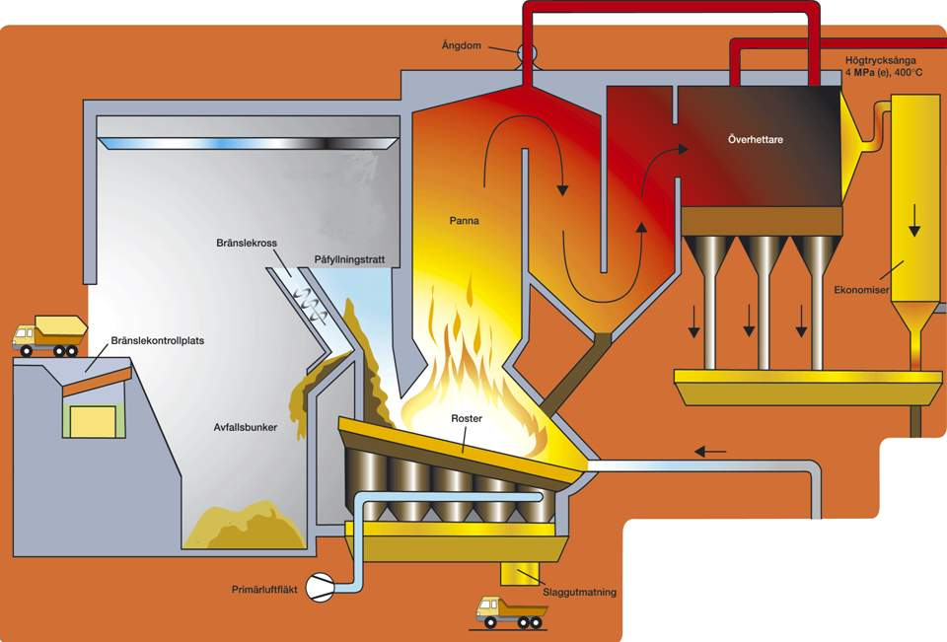

COST
Benefit
600 °C
>850°C >2 sek
Ca 24ton/h
<150 °C
1100 °C
Waste transportation
Auxiliary fuel
Flue gas treatment
Ash disposal
Steam
Heat
Waste receiving fee
Ca 6 ton/h

Slide 5
Utilization of municipal waste
Material recycling
Energy recovery
Cost
Benefit
Percent of
Mass
Conversion
efficiency
Overall
efficiency
RDF 40%
Energy 28%
30%
Municipal
waste
Energy 2%
Collecting
Treatment
25%
Composting
20%
recovery
Material
recycling
MBT Process
25%
Land fill
Notes:
In waste management it is not the efficiency of the process-step that counts, but it is the efficiency of the entire chain that counts.
It is obvious that for the stream with the highest quality an efficiency far above the average can be achieved. Good quality RDF can be burnt in a Coal-Fired Power Plant which should achieve easily 40% nowadays.
But the other streams from separation that arrive can hardly be processed in an energy-efficient way.
So processes that require pre-processing have to be assessed as an integral part of the chain, including all other streams coming from the separation process.
The recovery should be judged according to the quantities (in percent) of the recovery, but also to the quality of the materials and the quality of the final use.

Slide 6
Energy potential of waste
or
=
1 ton oil
1.6 ton coal
4.5 ton wood chips
or
or
5 ton wood waste
4 ton waste

Slide 7
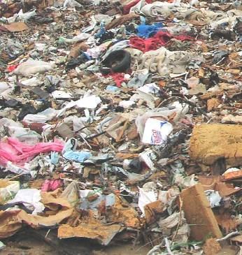
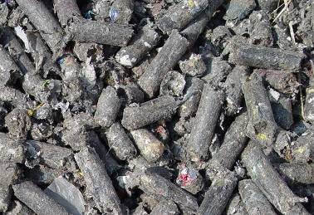
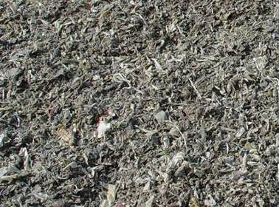
Thermal utilization of Waste
Incineration with heat recovery
40% thermal
5% Electricity
Low processing cost
Very costly for incineration
Very Low thermal efficiency
Fabricated RDF
HHV 4500~5500kcal/kg
80% thermal
25% Electricity
Municipal waste
HHV 2000-3500kcal/kg
Processing cost high
Stable operation
Fluff RDF
HHV 4500~7000kcal/kg

Slide 8
Solid Waste to energy conversion
Cost
Transportation of waste – low cost
Fuel fabrication
Transportation of waste fuel
Depreciation of energy plant and energy distribution system
Operation cost of energy plant
Ash and residue treatment
Environmental protection
Benefit
Public funding for waste treatment
Heat and electricity sold
Public benefit from safe disposal and zero emission

Slide 9
Biomass to energy conversion
Cost
Transportation of waste - high cost
Fuel fabrication – easy
Transportation of waste fuel
Depreciation of energy plant and energy distribution system
Operation cost of energy plant
Ash and residue treatment
Environmental protection
Benefit
Government reimbersement for waste treatment
Heat and electricity sold
Public benefit from safe disposal and zero emission
Carbon credit

Slide 10
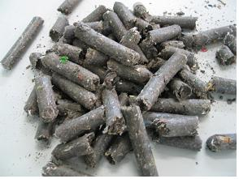
Waste to Energy network for industries
Waste Resources
Sludge
Wood
Power
Disposal
Plastic
RDF
Sludge
Wood
Co-gen.
Plastic
Disposal
RDF
Fabric
Heat
Heat Pump
Energy
VOC
Condense.
Energy

Slide 11

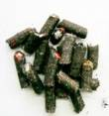
Waste to Energy network for metropolitan
< 50km
KPX
< 50km
RDF factory
Cogen.
Industry

Slide 12
Efficiency
Steam
Turbine
Ho [kJ/h]
P_{T} [kW]
P_{G} [kW]
G
P_{S} [kW]
He [kJ/h]
Boiler
P_{I} [kW]
Fuel
Hf [kJ/h]
Condenser
Hi [kJ/h]
Feed water

Slide 13
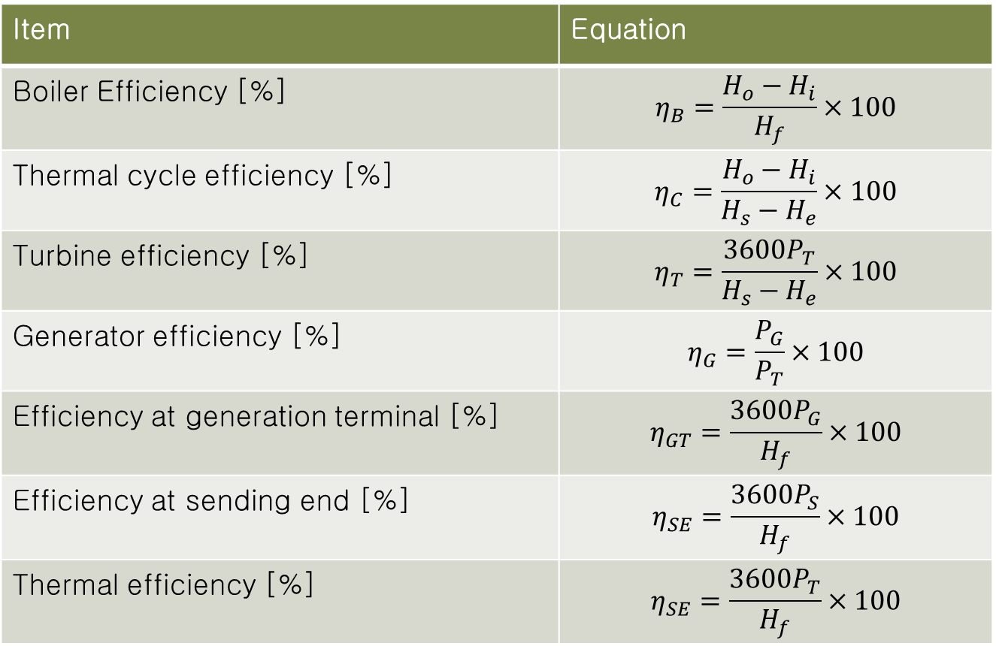
Power plant efficiency
Item | Equation
Boiler Efficiency [%] | $$η_{B}=\frac{H_{o}−H_{i}}{H_{f}}×100$$
Thermal cycle efficiency [%] | $$η_{C}=\frac{H_{o}−H_{i}}{H_{s}−H_{e}}×100$$
Turbine efficiency [%] | $$η_{T}=\frac{3600P_{T}}{H_{s}−H_{e}}×100$$
Generator efficiency [%] | $$η_{G}=\frac{P_{G}}{P_{T}}×100$$
Efficiency at generation terminal [%] | $$η_{GT}=\frac{{3600P}_{G}}{H_{f}}×100$$
Efficiency at sending end [%] | $$η_{SE}=\frac{{3600P}_{S}}{H_{f}}×100$$
Thermal efficiency [%] | $$η_{SE}=\frac{{3600P}_{T}}{H_{f}}×100$$

Slide 14
보일러의 증기조건
보일러 종류 | USC | SC발전 | 발전용 | 열병합 | 공정증기
발전용량, MWe | 550 | 450 | 500 | 10-50 | -
증기량, ton/h | 1300 | 1050 | 1700 | 50-300 | 10-20
증기온도, °C | 600 | 569 | 500-550 | 500 | 150-300
증기압, atm | 300 | 255 | 160-180 | 100 | 7-10
급수온도, °C 탈기기 이후 | 300 | 300 | 250 | 150 | 103

Slide 15
100MWth이란 무엇인가
100MWth output = 100*10^3 kjoule/sec
발전용 스팀의 열량(500℃ 100기압) 3434kJ/kg
급수(150℃ 100기압) 632KJ/kg
10^5/(3434-632)=35.7kg/sec
= 128ton/h
즉, 100MWth output은 시간당 약130ton 스팀을 생산하는 규모의 보일러

Slide 16
100MWe 란 무엇인가
100MWe = 100MW의 전기생산
100MW =100x10⁶ Joule/sec
보일러 발전 효율은 대개 35%
100/0.35 = 285MWth
즉, 100MWe는 약 300MWth의 출력을 가진 보일러
하루 석탄 사용량 300,000x3600x24/(0.85x24,000kJ/kg) = 1,270ton/day

Slide 17
TOE
1kWh = 1x3600/4.184 = 860kcal
LHV Fuel = 5000kcal/kg
Combustion efficiency = 99%
Boiler Efficiency = 88% by LHV
Turbine efficiency = 25%
1MWh = 1000 x 860/5000/(0.99x0.8x0.25)=790kg/h Fuel
Oil 1ton = 10^7 kcal
TOE = 790 x 5000/10^7= 0.4TOE/MWh

Slide 18
유연탄 Ton-C, Ton-CO₂
유연탄 IPCC 탄소 배출계수 = 1.059 (Ton-C/toe)
Ton-C = 연료의 toe × 1.059
Ton-CO₂ = Ton-C × (44/12) =시간당 탄소 배출량 Ton-C = 0.79 (toe) × 1.059 = 0.836 ton/hr (=5852 ton/yr)
시간당 이산화탄소 배출량 Ton-CO2 = 0.836 ton/hr × (44/12) = 3.065 ton/hr (=21420 ton/yr)

Slide 19
30 MWe SRF Power Plant
30MWe TOE per hour = 0.43 x 30 = 3.065 ton/hr =12.9 TOE
C emission per hour = 12.9 x 1.059 =13.66 ton C/h
CO2 emission per h our =13.66 × (44/12) = 50 ton CO2/h
REF; http://co2.kemco.or.kr/toe/toe.aspx

Slide 20
High plant power consumption
Max. 10~11% plant power consumptioin CFBC
300MWe Qinghuangdao plant reports 9%

Slide 21
감사합니다.

